Slide 1
PCube: Scaling LoRa Concurrent Transmissions with Reception Diversities
Xianjin XIA¹, Ningning HOU¹, Yuanqing ZHENG¹, Tao GU²
¹ The Hong Kong Polytechnic University
² Macquarie University, Australia
Sep 24, 2021
Notes:
Hello, xxx. I’m xxx, from HK PolyU.
I’m gonna present our latest work on LoRa concurrent communication, which is accepted in this year’s MobiCom.
This work is jointly performed by me, Hou and Prof. Zheng, and Prof Tao Gu from AU.

Slide 2
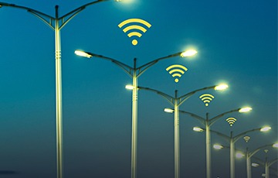


Connecting Internet-of-Things with LoRa
Smart city
Agriculture
Smart metering
Low power consumption
AA battery for 5+ years
Long communication range
~10 km
Low data rate
< 100 kbps
Notes:
LoRa is a new wireless technology that is specially designed for IoT communication.
As compared with existing IoT technologies such as WiFi, ZigBee and the latest 5G,
LoRa can not only consume low power, but also comm. over a long range.
For example, LoRa can generally transmit 10s of km in open areas, which is 100x longer than WiFi and ZigBee.
But LoRa makes a sacrifice on data rate. The max. data rate is less than 100 kbps.
So, LoRa is the best choice for IoT applications that have a low traffic requirement,
such as the agriculture soil monitoring and smart metering applications, which may need to transmit a few messages in several days.
You may wonder why LoRa can transmit at long range and consume low power at the same time.
I will try to explain from the PHY layer of LoRa.

Slide 3
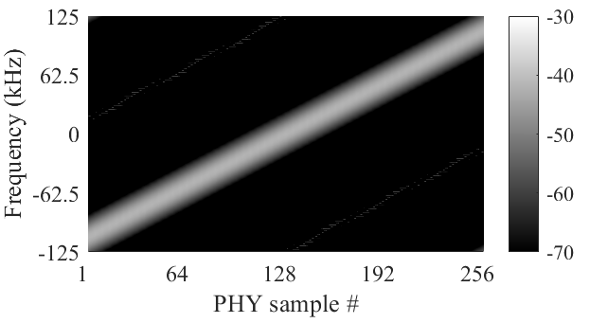
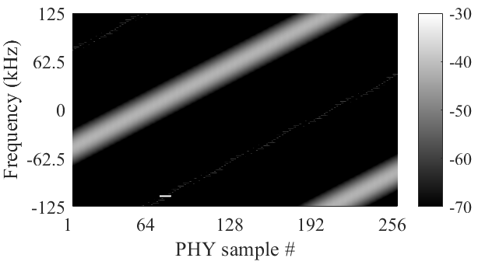
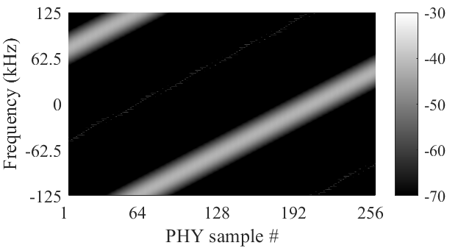
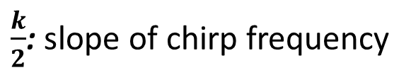

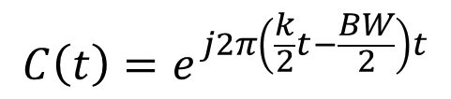
LoRa primer
Modulation: Chirp Spread Spectrum (CSS)
Base chirp
Modulated symbol #63
Modulated symbol #191
BW=250kHz
$$C\left(t\right)=e^{j2π\left(\frac{k}{2}t−\frac{BW}{2}\right)t}$$
$$S\left(t\right)={C(t)∙e}^{j2πf_{sym}t}$$
$\frac{k}{2}$: slope of chirp frequency
Notes:
The PHY layer of LoRa employs a CSS modulation technique.
A chirp is a signal whose frequency changes continuously with time.
This figure displays a base chirp. The BW is 250kHz. The freq. of base chirp increases from -125 to 125 kHz.
LoRa changes the initial frequency of base chirp to encode different data.
For example, these two figures display two modulated chirps for symbol #63 and #191.
Mathematically, a base chirp can be represented by C(t) in this expression.
Here k divided by 2 corresponds to the slope of chirp frequency.
And the process of symbol modulation can be modelled by this equation.
Here, f_sym is the initial frequency of a modulated symbol chirp, which represents the encoded data.

Slide 4
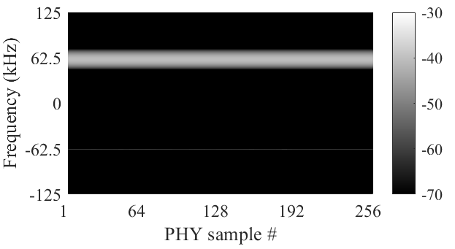
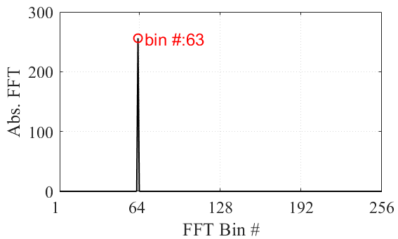
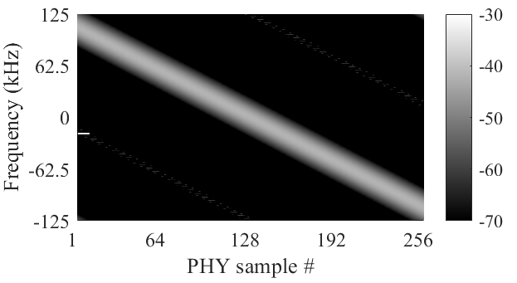



LoRa primer
Received symbol #63
$$S\left(t\right)={C(t)∙e}^{j2πf_{sym}t}$$
Dechirp
FFT
Standard down-chirp
$$C^{−1}\left(t\right)$$
Demodulation:
$$S\left(t\right)∗{C^{−1}\left(t\right)=e}^{j2πf_{sym}t}$$
Notes:
Okay, after knowing how LoRa modulation works,
Now, let’s look at how does a receiver decode data from received payload symbols.
This process is called LoRa demodulation.
Suppose this is the received symbol.
We want to recover f_sym from this chirp signal.
We know that f_sym corresponds to the initial frequency of the chirp.
Then how can we measure the initial frequency of a chirp signal?
We use a down-chirp signal.
A standard down-chirp is the conjugate of the base chirp.
So, if we multiply these two signals, we will get a single tone frequency, as shown in this figure.
And this resulting tone frequency is the initial frequency of the symbol chirp.
This process is called dechirp.
Finally, we can perform FFT on the dechirped signal to measure f_sym.
Since the dechirp operation aggregates all signal power into a single frequency bin,
Even if the signal power is below the noise floor, the frequency peak may still be higher than noise after accumulating power from all signal samples.
This is why a LoRa packet can be correctly received even when the SNR is negative.
It also explains why LoRa has a long comm. Range even when the packets are transmitting with low power.

Slide 5
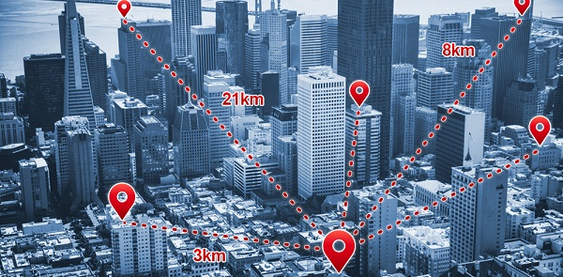
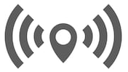
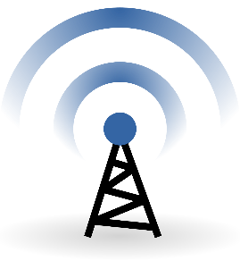

Communication collision
How can LoRa support a large number of IoT devices?
Notes:
As LoRa has a long comm range, a single gateway can cover a large area with 1000s of IoT devices.
If any two nodes transmit at the same time, their packets will collide
In scenarios like a smart city, IoT sensors are usually deployed with high density.
LoRaWANs may experience serious collisions,
and as a result, the performance may degrade significantly.
Then, how can LoRa support xxxx ?

Slide 6
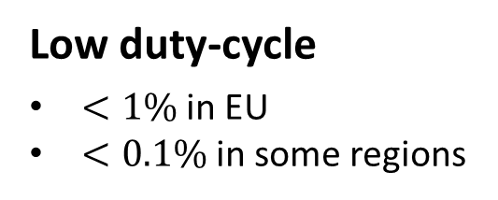

Concurrent Communication for LoRa
Orthogonal parameters
8 parallel decoders supported by COTS gateways
Low duty-cycle
$<1\%$ in EU
$<0.1\%$ in some regions
Multi-channel
200 kHz per channel
80 channels in US
Problems
Complex coordination among nodes
Low concurrency
Can we support more concurrent communications?
Notes:
LoRa supports concurrent comm using a set of orthogonal parameters.
For instance, a COTS gateway can support a max. of 8 packets communicating in parallel.
LoRa also regulates IoT sensors to comm. with low duty cycle and multi-channel to support more IoT connections.
However, it requires complex coordination among IoT nodes.
And the max. concurrency is still much lower than the number of IoT sensors.
So, in this study, we ask how can we support xxx for LoRa?

Slide 7
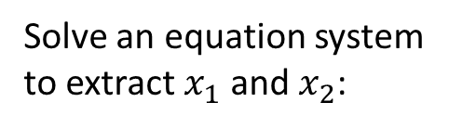


Concurrent Communication for LoRa
Multiple Input Multiple Output (MIMO)
h₁₁
y₁
Solve an equation system to extract $x_{1}$ and $x_{2}$:
x₁
TX1
h₂₁
RX1
h₁₂
$$y_{1}=h_{11}x_{1}+h_{12}x_{2}$$
x₂
TX2
RX2
y₂
h₂₂
$$y_{2}=h_{21}x_{1}+h_{22}x_{2}$$
Concurrency is limited by the number of antennas
Notes:
The first idea that comes out from our brain is MIMO.
In a MIMO system, the signal received by each antenna is a linear combination of all concurrent transmissions.
Where, y is xxx, x is xxxx, and h is the channel between antennas which can be measured in advance.
Basically, we can solve this equation system to extract the signals of each transmitter.
However, a problem with MIMO is that, the max. concurrency is physically limited by the number of antennas, which is still insufficient for many IoT communications.

Slide 8


Concurrent Communication for LoRa
Parallel packet decoding (i.e., collision recovery)
$$∆f=0.2$$
Choir [SIGCOMM’17]
FTrack [SenSys’19]
NScale [MobiSys’20]
CIC [SIGCOMM’21]
$$∆f=0.6$$
Notes:
The latest advances in LoRa parallel decoding have demonstrated the capability for using one antenna to decode multiple packets in parallel.
These works basically use some specific features of LoRa to resolve packet collisions.
The first category is Choir, which uses frequency domain features for collision recovery.
Choir observes that the signals transmitted by different devices have different fractional frequencies.
If we can extract the fractional frequency features, then we can use it as a fingerprint to separate collided symbols into different transmitters.
The second category uses time domain information for collision recovery.
The basic idea is that the symbol edges of collided packets are usually misaligned.
Then we can track the periodicity of symbol edges to separate collided symbols into different packets.
Some representative works are FTrack, Nscale and CIC which is presented in the last week.

Slide 9
Concurrent Communication for LoRa
Multiple Input Multiple Output (MIMO)
Concurrency is limited by the number of antennas
Parallel packet decoding (i.e., collision recovery)
One antenna for 5 (or more) packets reception in parallel
Can we combine multi-antenna and parallel decoding for more concurrent communications?
Notes:
So, generally, the concurrency of MIMO is limited by xxx.
And the latest advances on parallel decoding shows the potential for using one antenna to decode multiple packets.
So, we were wondering, is it possible to combine these two approaches for supporting more xxxx.

Slide 10
Multi-antenna for higher concurrency
More antennas do not add diversities to frequency and timing features of received packets
$$∆f=0.2$$
Rx1
Rx2
$$∆f=0.6$$
Notes:
Unfortunately, we find that if we simply combine multi-antenna and existing parallel decoding methods, we can only get very little performance gains.
The reason is that, when we use multiple antennas to receive, the time domain and frequency domain features of packets at one antenna are not likely to change at another antenna.
In other words, the two antennas will receive the concurrent packets with the same features.
For example, as the frequency domain fingerprint is determined by the hardware of this device, both Rx1 and Rx2 will extract a fractional frequency of 0.2.
Similarly, if Rx1 received two packets with well-aligned symbol edges,
It’s not likely that Rx2 receives the two packets with a large time gap.
right? This is not gonna happen.
Actually, if we want to use multi-antenna for higher concurrency, what we expect is that the same packets can be received by a different antenna with different features.
Then we can use the feature diversities for decoding more packets.

Slide 11
Multi-antenna for higher concurrency
Communication channel imprints phase features on received symbols
h₁
RX1
y₁
x
TX1
h₂
RX2
y₂
Channel diversities: Different antennas receive the same packet with different channels (i.e., different phase features)
Notes:
Our study exploits a fact that multiple antennas receive the same packet with different channels.
And the comm channels will actually leave some distinctive phase features on received symbols.
For example, the transmitted symbol will be received by Rx1 and Rx2 with the same frequency.
Here, the frequency of the demodulated symbols will locate in the same FFT bin.
But the phase of the symbol differs.
[click]
We can use the diversities of phase features to decode more packets.

Slide 12
PCube idea
Key insight: Symbols of different packets have different channel phases
Separate LoRa packet collisions using phase features
Notes:
So, a key insight of our work is that xxxxx.
We expect to extract the phase features of received symbols,
and use the phase features to separate symbols to different packets.

Slide 13
PCube idea
Phase-based parallel packet decoding:
Pkt 1
Pkt 2
Demodulation
…
Separated in I-Q
Notes:
Basically, we can demodulate the collided symbols in each demodulation window,
Which will produce multiple frequency peaks. Each of the peak corresponds to a symbol.
We can measure a channel phase from each symbol.
Then, we move to the next demodulation window and use the same method to demodulate and measure channel phase of symbols.
As symbols from the same packet are transmitted through the same channel, their channel phases will be the same.
So, if we display the phase of all symbols in an I-Q diagram, we can expect to see two clusters.
Each of the cluster corresponds to a packet.

Slide 14
PCube idea
More antennas add phase diversities to received symbols
Rx1
Rx2
Rx1
Rx2
Notes:
However, in practice, it may happen that two packets are received by an antenna with the same channel phase.
We cannot separate the two packets in phase at this antenna.
In this case, we can add a new antenna, for example, Rx2, which can receive the two packets with different channels.
We can use the channel diversities of multiple antenna to decode more packets.

Slide 15


Channel phase extraction
Objective: extract channel phase from symbols of collided packets
Raw phase measurement $≠$ Channel phase
Notes:
So, the key problem in our work is how to extract xxxx.
As we presented before, we can basically measure a phase from the FFT peak of demodulated symbols.
However, the raw phase measurement is not what we want.

Slide 16




Channel phase extraction
End-to-end communication channel:
RF front (TX) + Air-channel + RF front (RX)
$$h_{rx}^{rf}$$
$$h^{air}$$
Raw phase
measurement
Air-channel
$$h_{tx}^{rf}$$
h₁
RX1
y₁
$$h=h^{air}∙h^{rf}$$
x
TX1
h₂
RX2
y₂
Central Frequency Offset (CFO)
Sampling Timing Offset (STO)
Hardware phase offset
Notes:
The raw phase measurement corresponds to the phase of end-to-end comm channel, which includes three parts: the RF fronts of transmitter, wireless channel or air-channel, and finally the RF front of receiver radio.
The end-to-end channel can be written as the multiplication of air-channel and RF channels.
Only the phase of air-channel can be used as a phase feature, because air-channels are relatively stable and generally do not change during the transmission of a packet.
By contrast, the RF channels may include many frequency and phase offsets, which can lead to phase rotations and random changes of the measured phases.
So, the phase of RF channel must be excluded.
We next look at how to remove the impact of RF channel.

Slide 17
Central Frequency Offset
CFO: frequency disparity between Tx and Rx radios
BW of transmitter
Notes:
Let us first look at Central Frequency Offset, or CFO.
CFO is caused by xxxx.
Suppose this is the bandwidth of a transmitter. A LoRa packet is transmitted on this frequency band.

Slide 18
Central Frequency Offset
CFO: frequency disparity between Tx and Rx radios
BW of receiver
BW of transmitter
CFO
Real edge
Detected edge
Notes:
A receiver receives at a slight different frequency band.
And this is the CFO between Tx and Rx.
If we correlate received signal in this frequency band with a standard LoRa preamble, the detected symbol edge will be different from the real symbol edges. And this gap between edges is introduced by CFO.

Slide 19





Central Frequency Offset
CFO: frequency disparity between Tx and Rx radios
BW of receiver
BW of transmitter
CFO
$$∆t$$
$$∆t$$
$$C(t+∆t)∙e^{−j∆f_{cfo}t}$$
$$×$$
$$C^{−1}(t+∆t)∙e^{−j∆f_{cfo}t}$$
$${=e}^{−j2∆f_{cfo}t}$$
Notes:
Then, the problem is, if the detected symbol edges are incorrect, the extracted chirp signal would be incorrect either.
How can we correctly estimate CFO using incorrectly extracted chirp signals?
This problem can be solved by using two received chirps: an up-chirp and a down-chirp.
Both the up-chirp and the down-chirp have the same CFO and share the same delta t from the real symbol edges.
Since the down-chirp signal is the conjugate of an up-chirp, if we multiply the two signals, what we get is only related to CFO, or the frequency of CFO.
We can use this multiplication results to estimate CFO.

Slide 20


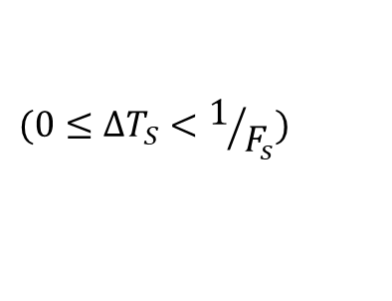


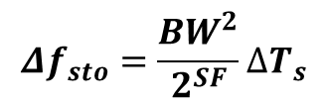

Sampling Timing Offset
Sampling Timing Offset (STO)
$$C\left(t\right)$$
$$y\left(t\right)=C(t)∙e^{j(∆f_{sto}t+φ_{sto})}$$
BW
$$Δf_{sto}=\frac{{BW}^{2}}{2^{SF}}∆T_{s}$$
Received base-chirp
Standard base-chirp
$$t_{0}$$
$$t_{1}$$
$$ΔT_{s}$$
$$(0≤∆T_{S}<1/{F_{s}})$$
Notes:
Next, let’s look at how sampling will affect the received chirp signals.
STO is the offset between the time when a signal arrives and the sampling time of a receiver.
Suppose this is the arrival time of the chirp, which is t0.
Receiver samples at discrete time. This time offset is Sampling Timing Offset.
Recall that the freq. of a chirp changes with time.
This time offset will transform into a corresponding frequency offset.
As a result, STO can introduce both frequency offset and phase offset on received signals.
This is different from WiFi. The sampling offset in WiFi will only introduce a phase offset.
But for LoRa, it will introduce both frequency offset and phase offset.
And the reason is that LoRa signal is a chirp signal, and the frequency of a chirp signal will change with time.
In practice, we can compare a received base chirp with a standard base-chirp to estimate the frequency offset of STO.

Slide 21






Calibrating frequency offset
Received chirp signal:
$$y\left(t\right)=$$
$$h^{air}∙h^{rf}∙$$
$$S(t,f_{sym})$$
$$y\left(t\right)=$$
$$h^{air}∙$$
$$e^{−j(∆f_{cfo}t+φ_{osc})}e^{j(∆f_{sto}t+φ_{sto})}e^{jφ_{var}}$$
$$∙S(t,f_{sym})$$
Symbol-level phase variance
How to remove random phase offsets?
Notes:
Generally, we can put all impacting factors discussed above into a unified signal model.
Suppose the transmitted chirp signal is S(t, f_sym).
The received signal contains both the air-channel and the RF channel.
We substitute this RF channel with CFO, STO and phase offset of radio hardware.
The final received signal will be like this.
We can use the method presented in previous slides to estimate the frequency offset of CFO and STO, and remove them from received signals.
However, the phase offset of radio hardware cannot be removed. It remains in the received signals.
How can we remove these random phase offsets?

Slide 22





Calibrating phase offset
Calibrate with a pair of synchronized Rx antennas (i.e., Rx-pair)
$$φ_{1}$$
h₁
$$y_{1}\left(t\right)=h_{1}^{air}∙e^{jφ_{var}}∙S(t,f_{sym})$$
RX1
y₁
x
TX1
h₂
$$φ_{2}$$
$$y_{2}\left(t\right)=h_{2}^{air}∙e^{jφ_{var}}∙S(t,f_{sym})$$
RX2
y₂
$$φ_{1}−φ_{2}=φ_{1}^{air}−φ_{2}^{air}$$
Raw phase measurement @ Rx1 and Rx2
Phase Difference of Air-channel (PDoA)
Notes:
Our solution is to use a pair of sync antennas to calibrate for the random phase offsets of radio hardware.
Since these two antennas are synchronized, their received signals will share the same hardware phase offset.
And the only difference between these two signals is the air-channel.
So, we can basically subtract the raw phase measurements of the two antennas to remove the random phase offsets of radio hardware.
And the resulting phase corresponds to the phase difference of air-channels between the two antennas.
We call the phase difference as PDoA, and use PDoA as a phase feature to separate collided symbols.

Slide 23
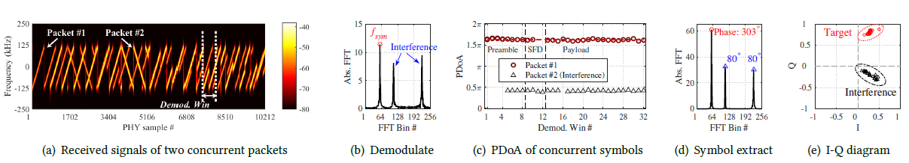
PDoA based parallel decoding
Notes:
This page gives the general workflow of how to extract PDoA and how to use PDoA for parallel decoding.
Firstly, each antenna will receive the signals of concurrent packets.
Then, it demodulates symbols in each demodulation window, which will produce multiple FFT peaks.
Next, we use the results of two Rx antennas to remove the impact of RF channel. And the obtained results correspond to the phase features of air-channels, or PDoA.
This figure shows that if we move to different demodulation windows, we can detect the same PDoA features for the symbols from the same packet. And symbols of different packets have different PDoA. We can basically separate the symbols of concurrent packets in the I-Q diagram.

Slide 24
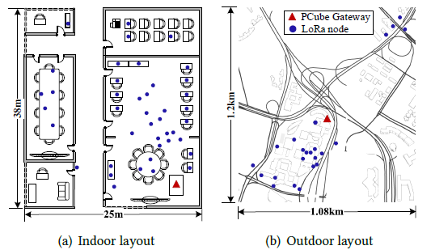
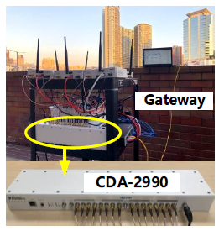
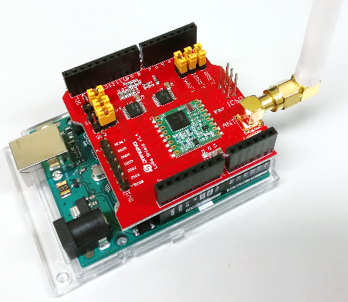
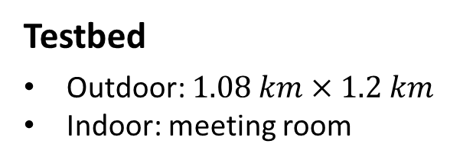
Evaluation
Testbed
Outdoor: $1.08 km×1.2 km$
Indoor: meeting room
Devices
Multi-antenna gateway: 8 USRP, shared clock
COTS LoRa nodes: Semtech SX1272
Metrics
Network throughput
Packet Reception Ratio (PRR)
Decoding capability
Notes:
We implemented a prototype system and performed both indoor and outdoor experiments to evaluate the performance of PCube.
This figure show our multi-antenna gateway which is composed of 8 USRPs.
All USRPs share the same clock source.
This gateway receives the signals of concurrent packets transmitted by COTS nodes
Then we PCube at a PC to decode the packets offline.

Slide 25
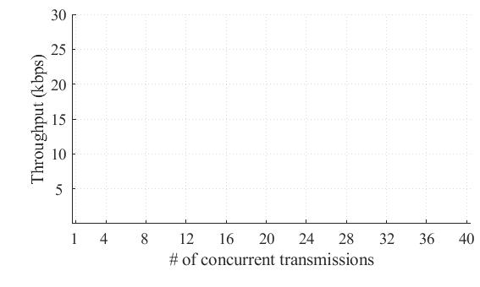
Throughput performance
Aggregated throughput of received packets
Notes:
In the experiment, we control different number of LoRa nodes to transmit at the same time. It makes the packets of all nodes colliding together.
The X axis displays the number of concurrent transmissions, which increases from 1 to 40.
The Y axis displays the aggregated throughput of correctly decoded packets.

Slide 26
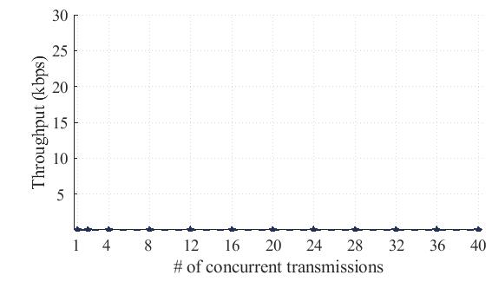
Throughput performance
Aggregated throughput of received packets
Standard LoRaWAN
Notes:
As a standard LoRa decoder cannot decode concurrent packets.
The throughput of standard LoRa decoder is close to 0 when more than one packet are transmitted in parallel.

Slide 27
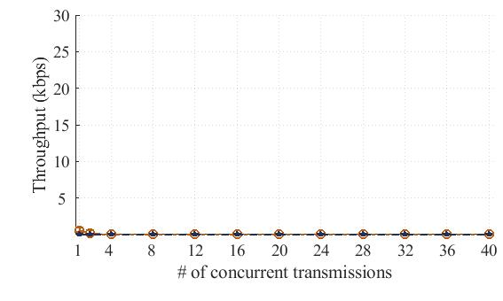
Throughput performance
Aggregated throughput of received packets
Choir
LoRaWAN
Notes:
Choir can decode at most two concurrent transmissions in our experiment.

Slide 28
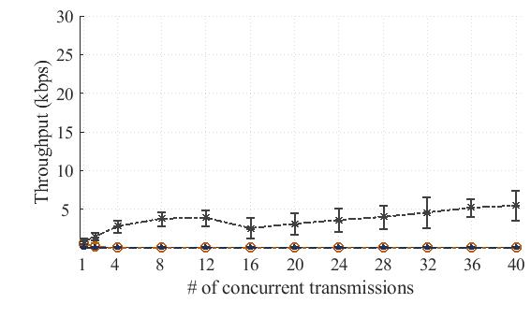
Throughput performance
Aggregated throughput of received packets
FTrack
Choir
LoRaWAN
Notes:
FTrack can decode more concurrent packets.
The throughput of FTrack increases as the number of concurrent packets increases from 1 to 4, then stops increasing when more than 4 packets are transmitted concurrently.

Slide 29
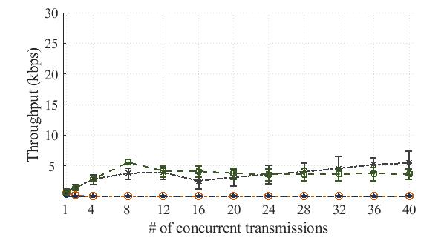
Throughput performance
Aggregated throughput of received packets
MIMO
FTrack
Choir
LoRaWAN
Notes:
MIMO can decode 8 concurrent packets, because we use 8 USRPs in our setting and the maximum number of antennas is 8.
The throughput of MIMO increases almost linearly as the number of concurrent packets increases from 1 to 8.

Slide 30
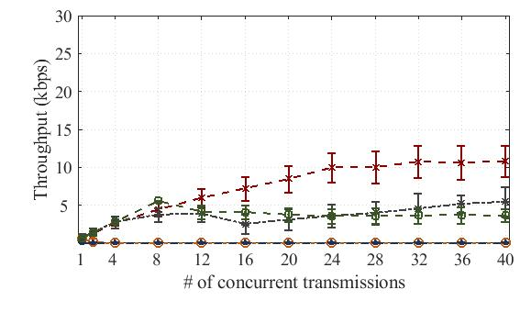
Throughput performance
Aggregated throughput of received packets
PCube (2 Rx)
MIMO
FTrack
Choir
LoRaWAN
Notes:
Then, this curve show the throughput of PCube with two Rx antennas.
When 8 packets are transmitted concurrently, the throughput of Pcube is slightly lower than that of MIMO.
But the throughput of Pcube continuously increases when more than 8 packets are transmitting.
The throughput stop going up when the number of concurrent transmissions are larger than 20.

Slide 31
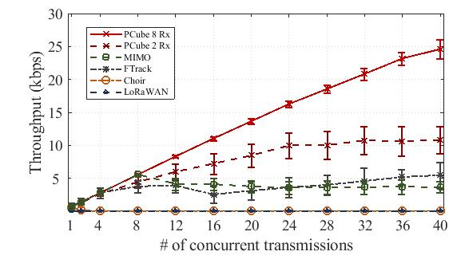
Throughput performance
Aggregated throughput of received packets
PCube (8 Rx)
PCube (2 Rx)
MIMO
FTrack
Choir
LoRaWAN
Notes:
If all antennas are used, Pcube can decode even more packets.
The throughput increases almost linearly with the number of concurrent transmissions.
The maximum number of concurrent packets that can be decoded by Pcube is about 36 when 8 antennas are used.

Slide 32
Conclusion
Collision recovery in a new phase domain, complementary with existing time- and frequency-domain approaches
Techniques for estimating/calibrating frequency and phase offsets of concurrent packets in the presence of collisions
Phase-based parallel packet decoder with higher decoding capability than traditional MIMO

Slide 33
Thank you!
Q&A

Slide 34
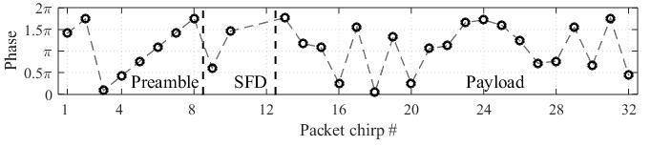
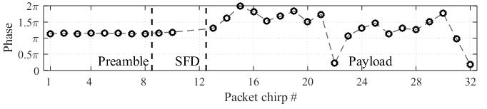
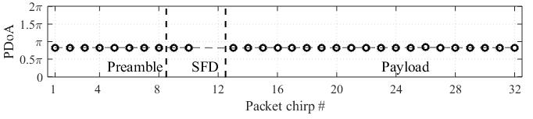
Calibration results
Raw phase measurement
Calibrating for frequency offset
Calibrating for phase offset

Slide 35
Scaling with multiple antennas
Rx-pair #1
Rx-pair #2
Rx-pair #N
…
PDoA measurement
…
Phase rotation and alignment
Combining

Slide 36
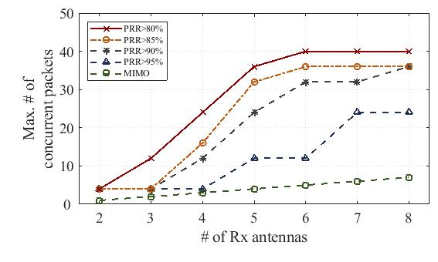
Decoding capability
Maximum number of received packets
PCube (80% PRR)
PCube (85% PRR)
PCube (90% PRR)
PCube (95% PRR)
MIMO

Slide 37
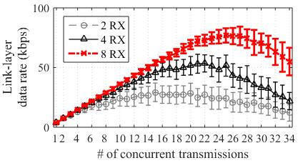
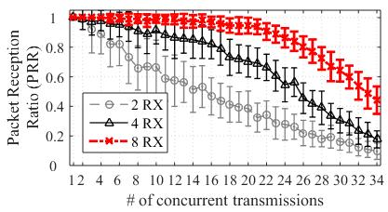
Decoding performance (SF8, BW250kHz)

